Slide 1



Topic: Storm and Heavy Rainfall Prediction
College: Lokmanya Tilak College of Engineering
Students: Kushal Nishad
Saurav Patil
Ruturaj Desai

Slide 2

Learning Objectives
Understand the significance of weather prediction in disaster prevention
Learn how to preprocess and analyze weather datasets
Apply machine learning algorithms to forecast heavy rainfall and storms
Evaluate model performance using real-world metrics
Explore deployment of AI-based weather prediction systems
GOAL

Slide 3
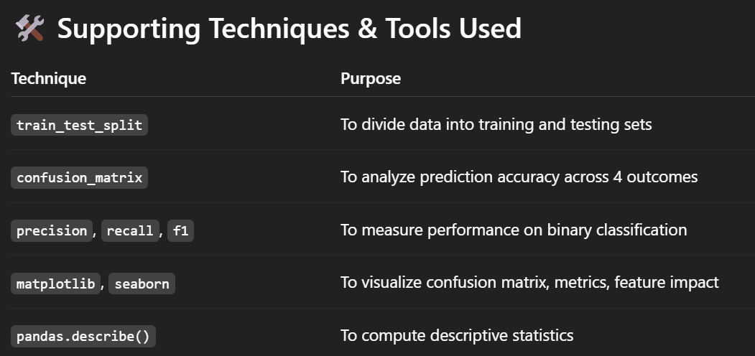

Slide 4
Methodology
1.Data Loading
Loaded rainfall dataset using pandas.
2.Label Creation
Created a binary target: High_Rainfall = 1 if ANNUAL > 3000 mm, else 0.
3.Feature Selection
Used seasonal rainfall features: Jan-Feb, Mar-May, Jun-Sep, Oct-Dec.
4.Data Splitting
Split data into training and test sets (80:20 ratio).
5.Model Training
Trained a Logistic Regression model on the training data.
6.Prediction
Predicted rainfall class on the test data.
7.Evaluation
Measured accuracy, precision, recall, F1 score, and visualized the confusion matrix.
8.Visualization
Plotted performance metrics and feature importance using matplotlib and seaborn.

Slide 5
Alogrithms used:
🧠 1. Logistic Regression
🔷 Type:
Supervised Learning
Classification Algorithm
🔷 Purpose in This Project:
To classify whether a district has high annual rainfall (above 3000 mm) or not.
🔷 Why Logistic Regression?
Our target variable is binary (High_Rainfall = 1 or 0)
Logistic regression is ideal for binary classification
It provides interpretable coefficients showing feature influence

Slide 6
Problem Statement:
Unpredictable rainfall and storms cause massive damage to life, agriculture, and infrastructure. Traditional systems often lack real-time accuracy. The challenge is to build an AI model that can forecast these events early and reliably.
Solution:
A machine learning-based solution that:
Predicts storm or heavy rain likelihood from historical weather inputs
Uses classification (e.g., logistic regression)
Generates alerts for potential disasters with minimal false positives

Slide 7
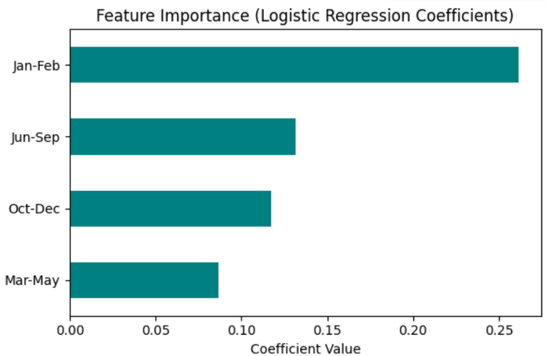
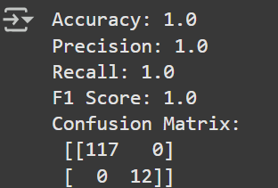
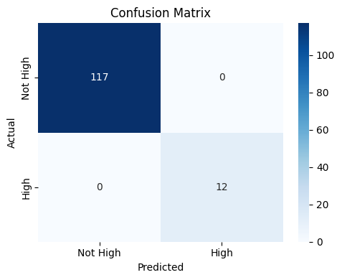
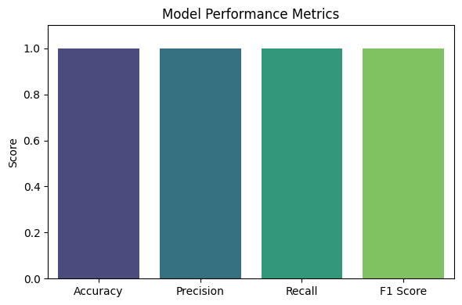
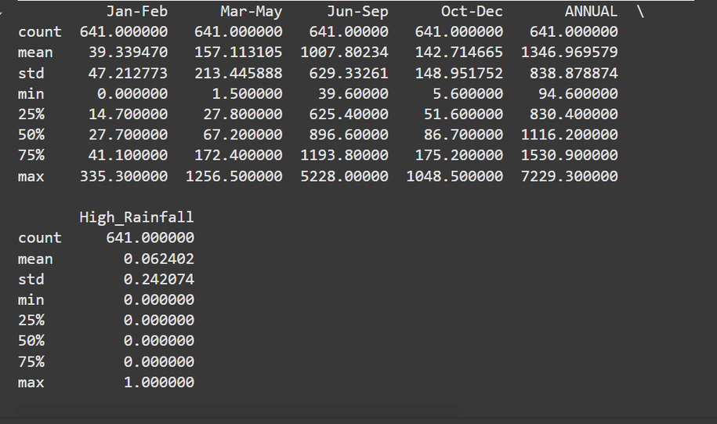
Screenshot:

Slide 8
Conclusion:
The AI/ML model provides a data-driven approach to predicting heavy rainfall and storms. It supports early warning systems, urban planning, and agricultural decision-making. With further training and integration into live weather systems, it can significantly reduce risk and improve preparedness.
GitHub repository link of the project
https://github.com/Soro2006/edunet

